Slide 1
3. The Realities of Software Testing
♦Unfortunately, in the real world you will never see a project perfectly follow any of the development models.
♦ You will never be given a thoroughly detailed specification that perfectly meets the customer's needs and
♦ you will never have enough time to do all the testing you need to do.
♦ But, to be an effective software tester, you need to understand what the ideal process is so that you have something to aim for.

Slide 2
3. The Realities of Software Testing
Why software can never be perfect
Why software testing isn't just a technical problem
The terms commonly used by software testers

Slide 3
软件测试的现实
♦ (1) It's Impossible to Test a Program Completely
♦ (2) Software Testing Is a Risk-Based Exercise
♦ (3) Testing Can't Show That Bugs Don't Exist
♦ (4) The More Bugs You Find, the More Bugs There Are
♦ (5) The Pesticide Paradox

Slide 4
软件测试的现实
♦ (6) Not All the Bugs You Find Will Be Fixed
♦ (7) When a Bug's a Bug Is Difficult to Say
♦ (8) Product Specifications Are Never Final
♦ (9) Software Testers Aren't the Most Popular Members of a Project Team
♦ (10) Software Testing Is a Disciplined Technical Profession

Slide 5
（1）It's Impossible to Test a Program Completely
The number of possible inputs is very large.
The number of possible outputs is very large.
The number of paths through the software is very large.
The software specification is subjective.
You might say that a bug is in the eye of the beholder(旁观者).

Slide 6
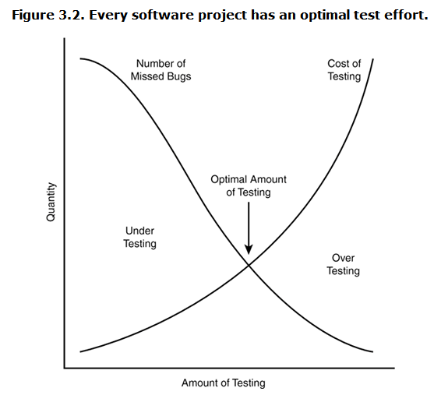
（2）Software Testing Is a Risk-Based Exercise

Slide 7
Software Testing Is a Risk-Based Exercise
One key concept that software testers need to learn is
♦ how to reduce the huge domain of possible tests into a manageable set,
♦ and how to make wise risk-based decisions on what's important to test and what's not.

Slide 8
（3） Testing Can't Show That Bugs Don't Exist
♦ You can perform your tests, find and report bugs,
♦ but at no point can you guarantee that there are no longer any bugs to find.
♦ You can only continue your testing and possibly find more.

Slide 9
（4）The More Bugs You Find, the More Bugs There Are
Programmers have bad days.
Programmers often make the same mistake.
Some bugs are really just the tip of the iceberg.

Slide 10
(4)The More Bugs You Find, the More Bugs There Are
多个软件缺陷相互关联，甚至是由同一个原因造成的。缺陷的“传递”和“放大”。
找到软件缺陷越多的模块，遗留的软件缺陷越多。
如果某软件无论如何也找不出软件缺陷，也可能是软件经过精心编制，确实存在极少的软件缺陷。

Slide 11
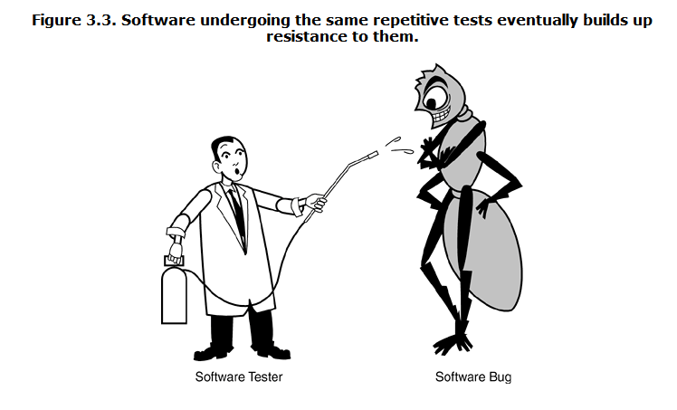
（5）The Pesticide Paradox（杀虫剂怪事）

Slide 12
（6）Not All the Bugs You Find Will Be Fixed
There's not enough time.
It's really not a bug.
It's too risky to fix.
It's just not worth it.
The decision-making process usually involves the software testers, the project managers, and the programmers.

Slide 13
（7）When a Bug's a Bug Is Difficult to Say
The software doesn't do something that the product specification says it should do.
The software does something that the product specification says it shouldn't do.
The software does something that the product specification doesn't mention.
The software doesn't do something that the product specification doesn't mention but should.
The software is difficult to understand, hard to use, slow, or in the software tester's eyes will be viewed by the end user as just plain not right.

Slide 14
（8）Product Specifications Are Never Final
As a software tester, you must assume that the spec will change. Features will be added that you didn't plan to test. Features will be changed or even deleted that you had already tested and reported bugs on. It will happen.

Slide 15
（9）Software Testers Aren't the Most Popular Members of a Project Team
——The goal of a software tester is to find bugs, find them as early as possible, and make sure they get fixed.
Your job is to inspect and critique your peer's work, find problems with it, and publicize what you've found. Ouch! You won't win a popularity contest doing this job.
1、Find bugs early.
2、Temper your enthusiasm.
3、Don't just report bad news.

Slide 16
（10）Software Testing Is a Disciplined Technical Profession
This is great news if you're interested in software testing.
It can now be a career choice a job that requires training and discipline, and allows for advancement.

Slide 17
程序员避免测试自己的程序
原因1：心理学因素
当一个程序员在完成了设计，编写程序的建设性工作后，要一夜之间突然改变他的观点，设法对程序形成一个完全否定的态度，那是非常困难的。
大部分程序员都由于不能使自己进入必要的精神状态（不是抱着要揭露出自己程序中错误的态度），因而不能有效地测试自己的程序。
心理作用：对自己的程序“偏心” ,不愿否定自己写的程序（特殊感情）。可以把测试看做是对一篇论文或—本书作校对，或与写评论相类似的工作。正如许多作者所知，校对或批评自己的著作是非常困难的。也就是说，在自已的工作中找出缺陷往往是人的心理状态所不容忍的。

Slide 18
程序员避免测试自己的程序
原因2：思路受局限
难以发现功能理解错误。
程序中可能包含由于程序员对问题的叙述或说明的误解而产生的错误。如果是这种情况，当程序员测试自己的程序时，往往还会带着同样的误解致使问题难以发现。

Slide 19
声明
以上看法并不意味着程序员不可能测试自已的程序。
不过相比之下如果由另外—些人来进行程序测试，就会更有效、更成功。
注意：这个论断并不适用于纠错（改正已知错误），由原来程序的作者纠错肯定效率更高。

Slide 20
谁来完成测试
1、开发者测试
2、对等测试
3、独立测试小组
4、独立测试机构

Slide 21
独立测试
独立测试是指软件测试工作由在经济上和管理上独立于开发机构的组织进行。

Slide 22
独立测试的好处
采用独立测试方式，无论在技术上还是管理上，对提高软件测试的有效性都具有重要意义 。
①、客观性
②、专业性
③、权威性
④、资源有保证

Slide 23
验证与确认
确认(Validation)
  为确定系统或部件是否满足需求的评估过程。
  一般采用动态测试的方式(基于程序的运行)。
  通过检查并收集客观的证据来确定针对某种特定需求在提供时满足预期的使用。
  确认活动适用于产品在其诸如运行、培训、制造、维护、以及支持服务等任何预期环境中的任何方面。确认活动即可以用于工作产品，也可以用于产品或产品部件。
  确认活动常常需要用户的参与。

Slide 24
验证与确认
验证：构造的产品正确吗？------ 评审
确认：是否构造了正确的产品？------ 测试

Slide 25
QC和QA
质量控制
  验证产品的正确性，当发现与设计不一致的时候进行纠正。
质量保证
  充当支持执行全面质量管理的角色

Slide 26
测试和QA
软件测试员（QC）：检测软件产品
找出缺陷，
评价软件质量
质量保证人员（QA）：检测软件过程
创建和加强促进软件开发并防止软件缺陷的标准、方法和过程。

Slide 27
测试和QA
在小型软件公司，可能QA和QC的工作交织在一起，人员交叉和兼任的情况比较普遍。
大公司，有专门的测试部门和质量部门，有专职的测试人员和质量人员。

Slide 28
SQA与软件测试的关系
SQA 是管理工作、审查对象是流程、强调以预防为主
测试是技术工作、测试对象是产品、主要是事后检查
SQA指导测试、监控测试
测试为SQA提供依据

